Slide 1
Disperse Slot Intimation System for Civil Supplies Department
Presented by:
JANANI T
22MCA502

Slide 2
Problem Statement
Government ration shop is established to serve Indian citizen by providing the food materials for affordable cost.
But due to delay in supply all citizen needs to come to the ration shop and ask them whether they are providing the items today.
Because of this problem when the items are provided people stand in big queue fighting for the items thinking that they won’t get items.
The people need to stand in a long queue to get the commodities which leads to waste of time for the people. This creates crowd in ration shops.
If they are aware of the items content and when they are provided then it will be helpful for them.

Slide 3
Objective
Aim
The aim of this project is to modernize the Public Distribution System (PDS) in India by leveraging technology, specifically through the implementation of a virtual queuing system powered by the Q-Learning algorithm.
Objectives
To Implement Virtual Queuing System
To Enable SMS-Based Slot Allocations
To Provide Flexibility with Re-slot Allocations
To Establish Online Accessibility for Product Details
To Showcase Q-Learning Efficiency

Slide 4
Introduction
Public distribution system (PDS) is food security and food distribution system formed by the Government of India for providing food grains at affordable rates to poor section of population in the country.
The system is jointly managed by central and state government.
PDS intend to provide the basic food grains i.e. wheat, rice, sugar and kerosene oil to beneficiaries at subsidized rates.
The Public Distribution System faces severe criticism on several grounds.
The operational responsibilities including allocation within the State, identification of eligible families, issue of Ration Cards and supervision of the functioning of Fair Price Shops (FPSs) etc.,

Slide 5
Abstract
With all businesses needing to implement social distancing and new security measures due to the COVID-19 crisis. One of the solutions to keep social distancing while providing services is using a virtual queue management system.
In this project the queuing system is changed to disperse slot allocation on specific time using Deep Q Learning
SMS notification is sent to customer giving prior dates for the collection of products on stipulated time for every card holder, saves time by logging online and views product details.
If the card holder missed the first slot allocation, gives another chance to get the products by providing re-slot allocation for the next purchase of products, in case not able to deliver products on first slot.

Slide 6
Existing System
The Civil Supplies Department has issued coupons to the beneficiaries, mentioning the time slot for them to avail food grains, commodities and relief fund.
Virtual Queue System in remote manner-Queuing solutions are specially designed to manage queues outside your store virtually, thereby ensuring social distancing.
Drawback
But this method needs manual resources and prolonged time.
Have to check the process continuously.
Booking an appointment on a web page

Slide 7
Existing System
Standard Linear Queues: This form of queuing represents the normal or standard queue system where each service desk or cashier has a separate line.
Single Line Queues: Also referred to as a Call Forward System, a single line groups customers and then feeds them to multiple cashiers or service areas. Often, Individual service stations are allocated to different service personnel part of one long counter or desk.
Dispersed or “Digital” Queues: This type of queue management disperses waiting lines by offering a ticketing management system.
First Come, First Served (FCFS): this mode is commonly applied real-world situations, such as tellers in a bank.
Priority Discipline (PD): Under this discipline, customers are classified into categories, then each category is given different priorities.

Slide 8
Disadvantages
Existing techniques are full of complications and queues tend to have long waiting hours.
Waiting in lines is very inefficient, customers have to be in line in order to be served even if the line may have more than a hundred customers ahead.
Regional Disparities
PDS dealers are sometimes found resorting to malpractices like diverting the grains to open market to get better margin
The irregular opening of the shops

Slide 9
Proposed System
The proposed project to modernize the Public Distribution System (PDS) in India by implementing a virtual queuing system through the Q-Learning algorithm is a forward-thinking approach to address the challenges faced by Fair Price Shops.
Virtual Queuing System: The implementation of a virtual queuing system using Q-Learning algorithm is a significant step towards reducing the physical queues at Fair Price Shops. This approach leverages technology to streamline the distribution process.
Slot Allocations through SMS Notifications: Ration cardholders would receive SMS notifications specifying the date and time for product collection. This helps in organizing and optimizing the distribution process, allowing beneficiaries to plan their visits accordingly and eliminating the need for daily visits.

Slide 10
Advantages
Reduce customer walkaways by 60%
Centrally Controllable & Easy to Use
Organizes Service Area and reduces customer waiting times
Enables efficient management of customer journey
Optimizes Staff Performance & increase retention
No Lines Smarter Citizens.
Enhance customer communication and engagement
Seamlessly manage customer flow.
Monitor your workflows in real-time.
Enabled Safer Socially Distanced Interactions

Slide 11



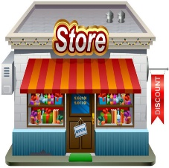
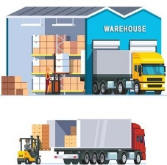

System Architecture
Access Policy
Data Manipulator
QLess Module
Notification Module
Report Generator
Web App Modules
Login
Family Card
Slot Generation
Ration Shop
Send Notification
RS Employee
Update Mobile Number
Stock Details
Stock Status
Report
Shop Admin
Super Admin
Track Purchase
Slot wit Date &Time
Set Prefered Time
Login
Citizen

Slide 12
System Requirements
Hardware Requirements
Processors : Intel® Core™ i5 processor,8 GB of Ram
DRAMDisk space : 320 GB
Operating systems : Windows® 10, macOS*, and Linux*
Software Requirements
Server Side : Python 3.7.4(64-bit) or (32-bit)
Client Side : HTML, CSS, Bootstrap
IDE : Flask 1.1.1
Back end : MySQL 5.
Server : Wampserver 2i

Slide 13
Modules List
1. DS Ration Distribution Web App
2. Access Control Module
3. Disperse Slot Generator
4. End User Module
4.1. Super Admin
4.2. Shop Admin
4.3. Citizen
5. Auto Notification Engine
6. Reports

Slide 14
Modules Description
DS Public Distribution Web Dashboard
The Disperse Slot Public Distribution Web Dashboard is a user-friendly interface designed to enhance the efficiency and accessibility of the public distribution system.
Powered by advanced slot dispersion technology, this dashboard provides real-time updates, allowing users to manage and monitor virtual queuing, slot allocations, and product details seamlessly.
Experience a modernized approach to public distribution, ensuring a streamlined and user-centric process for both administrators and beneficiaries.

Slide 15
2. Disperse Slot Generator and Forecasting
In this module, the disperse slot generator generates the time slot for each and every consumer with Deep Q Learning.
This system utilizes Deep Q Learning algorithms for slot dispersion, ensuring an efficient and equitable distribution of resources. Additionally, it integrates powerful forecasting the slots to the consumer.
Experience a smarter, data-driven approach to public distribution, enhancing accessibility and minimizing wait times for beneficiaries.
Consumers notify by sms and email they can collect them from their ration shops on the specified day and time, including the extra rice and relief fund announced as part of COVID-19 relief measures.

Slide 16
3. Access Control Module
Step 1: Register
Step 2: Login
Step 3: Add or Update or Delete
Ration Shop Admin Master: This module is used to add the area wise ration shop staff and their details
Area Master: This module is used to add the area name.
Area Ration card details: It is used to add the details of the head and members of the family.
Stock Master: Add stock, allot stock area wise and notify the stock availability
Step 4: Report Maintenance

Slide 17
4. Ration Shop Admin
In this module the ration shop admin can enter with their login credentials. The shop admin has a live dashboard to generate time slot and token id.
The shop admin also keeps track of queuing numbers, wait times and service times. Schedule, reschedule and cancel appointments digitally to manage customer traffic and reduce operational costs.
The shop admin can have unique registration id to maintain their details in database.
Admin logged in to their page, they will verify the stocks are available or anything to order from the government and maintain the product, employee and customer records.

Slide 18
5. Consumer
In this module, customer can view the available products in their home page.
This module consists of the details of the customer who gets the notification of date and time to buy the stock from the ration shop.
The consumer can then add the possible time options and also request for reschedule the date and time.
They can able to view the purchase history by simply logged with their card number.

Slide 19
6. Automatic Notification System
This module generates the OTP for consumer login these OTP send through by SMS and Email of the consumer. Another SMS and Email with the Date and Time to buy the ration commodities sent to the consumer mobile number and mail id provided.
Auto generated SMS are
OTP
Disperse Slot
Reschedule Disperse Slot
Relief Fund
Thank you

Slide 20
Table Design
Table structure for table rq_admin
Field | Type
username | Varchar (20)
password | Varchar (20)
Table structure for table rq_ration_shop
Field | Type | Key
id | Int (11)
ration_shop_id | Varchar (20) | Primary key
address | Varchar (30)
area | Varchar (20)
district | Varchar (20)
pincode | Varchar (20)
phone_number | Varchar (20)
register_date | Varchar (20)

Slide 21
Table Design
Table structure for table rq_employee_details
Table structure for table rq_product_details
Field | Type | Key
id | Int (11)
ration_shop_id | Varchar (20) | Foreign key
employee_id | Varchar (20) | Primary key
name | Varchar (20)
address | Varchar (50)
mobile | Bigint (20)
email | Varchar (40)
password | Varchar (20)
assistant_name | Varchar (20)
assistant_address | Varchar (50)
assistant_mobile_number | Bigint (20)
assistant_email | Varchar (40)
register_date | Varchar (20)
Field |  | Key
product_id | Int(11) | Primary key
product | Varchar(50)
product_type | Int(11)
price | Int(11)

Slide 22
Table Design
Table structure for table rq_consumer_details
Table structure for table rq_stock_details
Field | Type | Key
id | Int (11)
ration_shop_id | Varchar (20)
name | Varchar (20)
card_number | Varchar (20) | Primary key
mobile_number | Bigint (20)
email | Varchar (40)
address | Varchar (50)
prefer_day | Varchar (100)
prefer_time | Varchar (20)
prefer_status | Int (11)
reschedule_status | Int (11)
allotted_slot_time | Varchar (20)
Field | Type | Key
id | int(11)
ration_id | varchar(20) | Foreign key
product_id | int(11)
product | varchar(30)
price | int(11)
available_quantity | int(11)

Slide 23
Table Design
Table structure for table rq_product_delivery
Table structure for table rq_stock_request
Field | Type | Key
id | Int (11)
ration_id | Varchar (20)
timeslot_id | Int (11) | Foreign key
card_number | Varchar (20)
allotted_slot_time | Varchar (20)
deliver_status | Int (11)
delivered_product | Varchar (200)
bill_amount | Int (11)
month | int(11)
year | Int (11)
date_time | Timestamp
Field | Type | Key
id | Int (11)
ration_id | Varchar (20) | Foreign key
product | Varchar (100)
required_quantity | Int (11)
request_date | Timestamp

Slide 24
Table Design
Table structure for table rq_timeslot_allocation
Field | Type | Key
timeslot_id | Int (11) | Primary key
ration_id | Varchar (20)
given_date | Varchar (20)
start_time | Varchar (20)
end_time | Varchar (20)
slot_duration | Int (11)
break_time | Varchar (20)
slot_mode | Varchar (20)
allocation_date | Timestamp
month | Int (11)
year | Int (11)

Slide 25
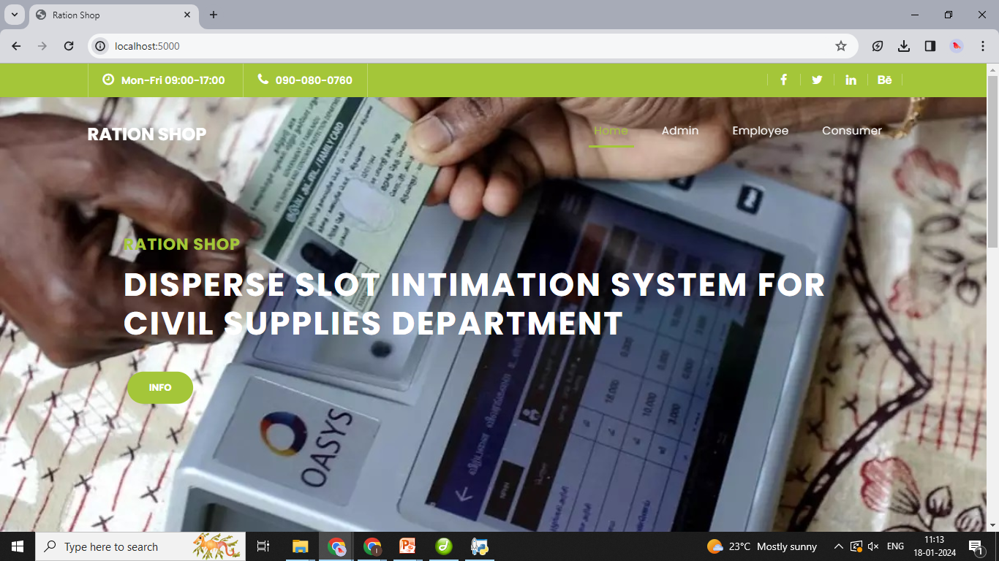

Form Design

Slide 26
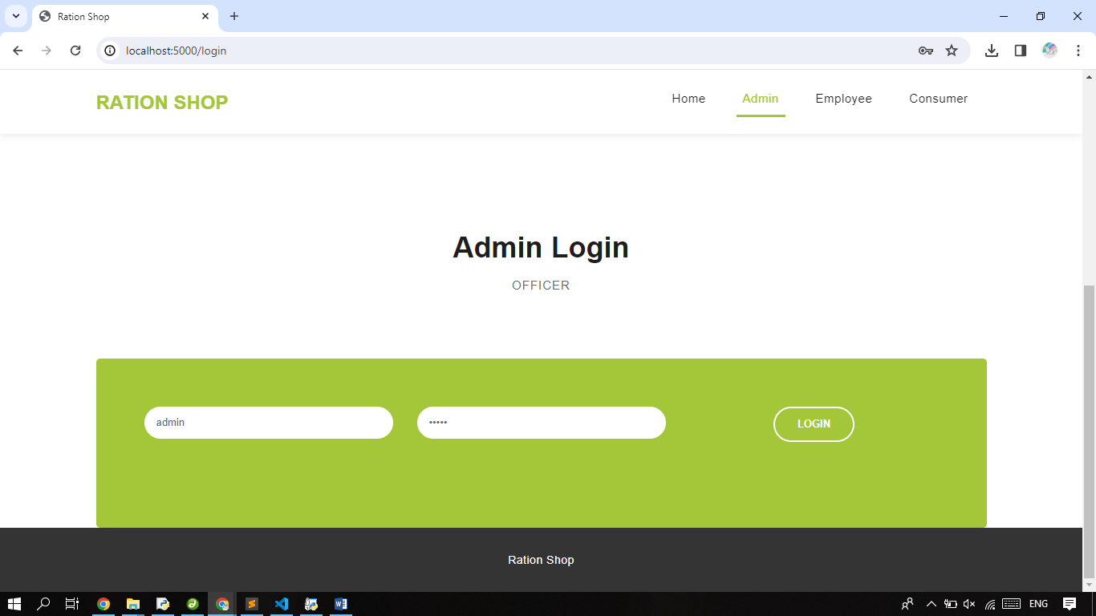
Form Design

Slide 27
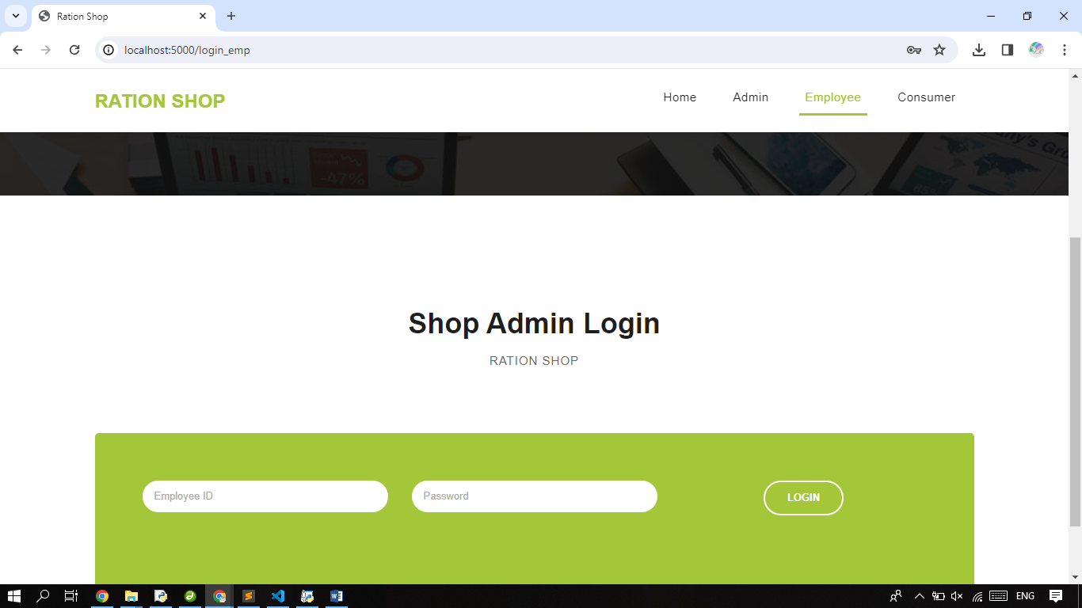
Form Design

Slide 28
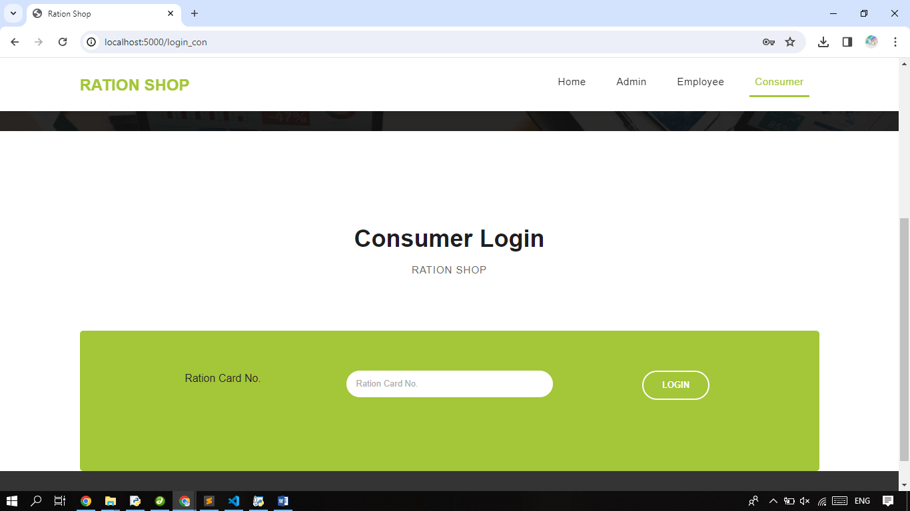
Form Design

Slide 29
Physical Design

Slide 30
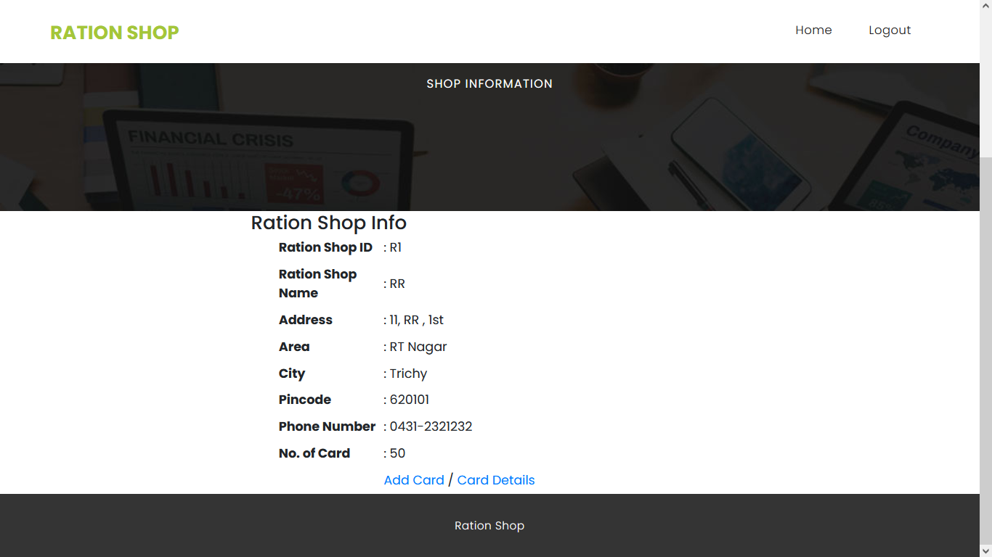
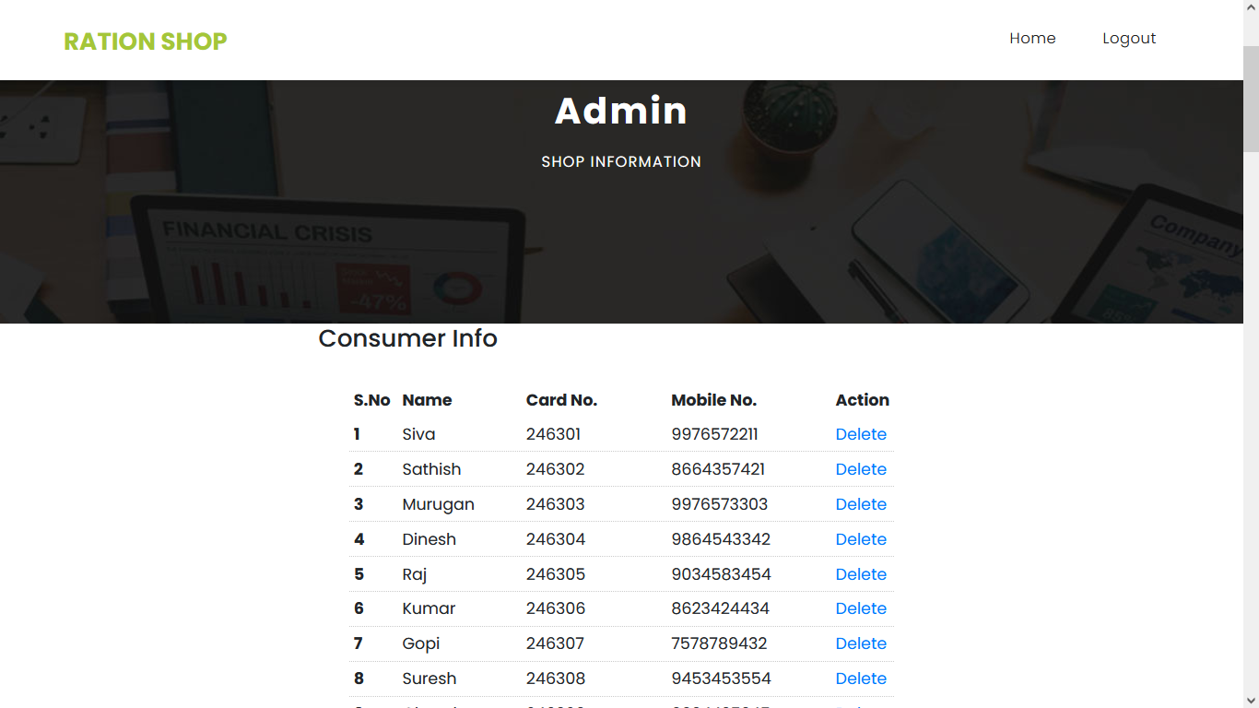
Development

Slide 31
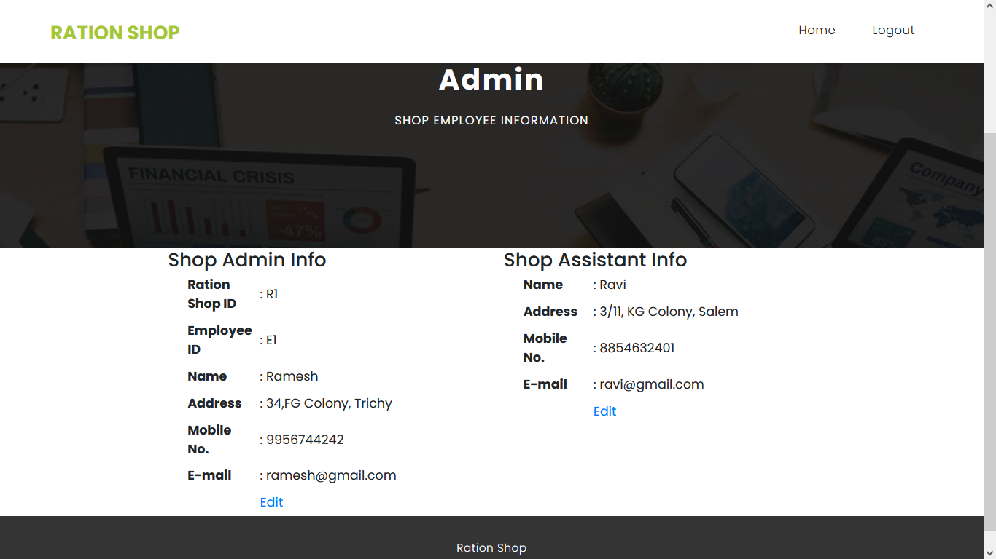
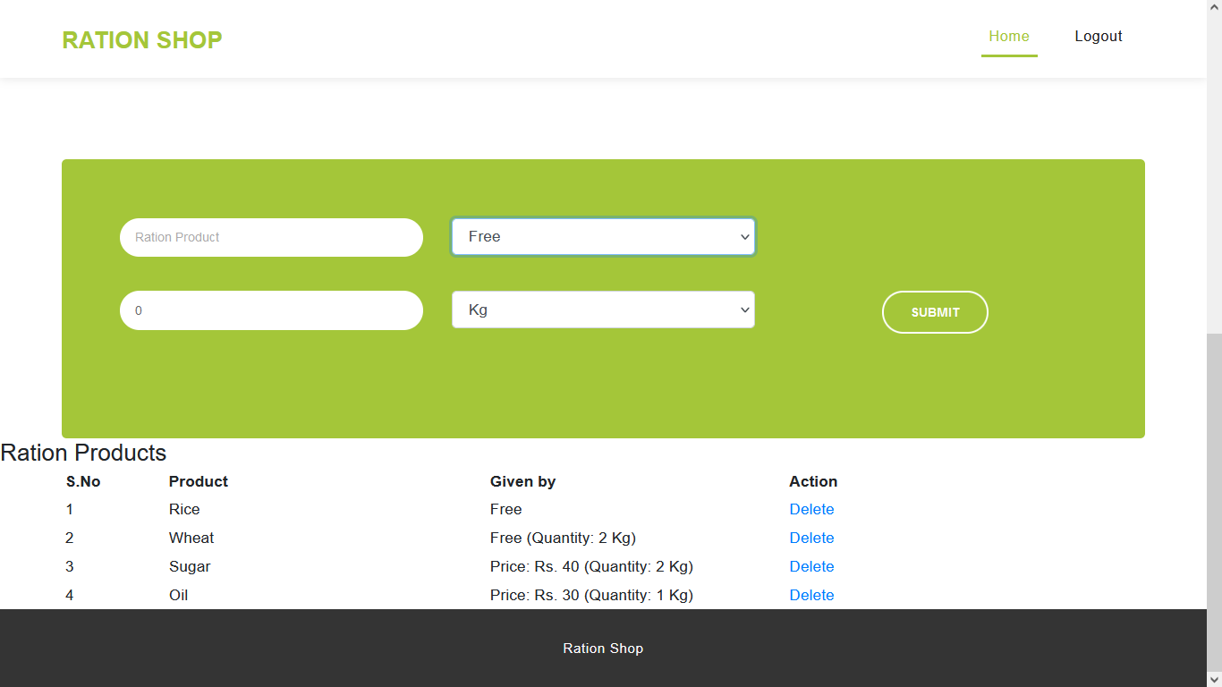
Development

Slide 32
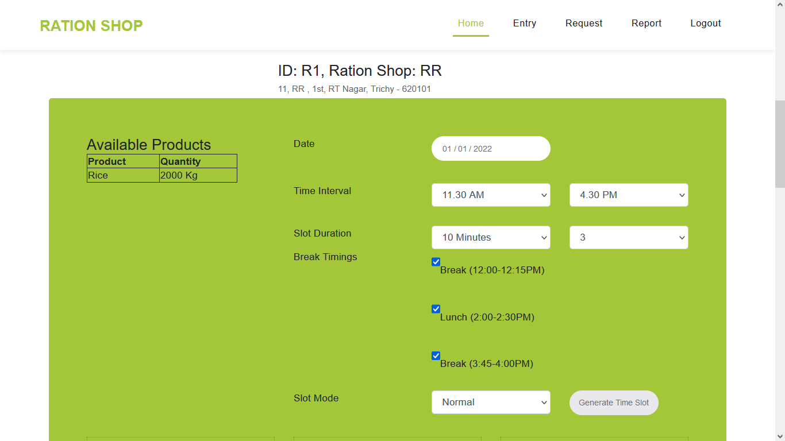
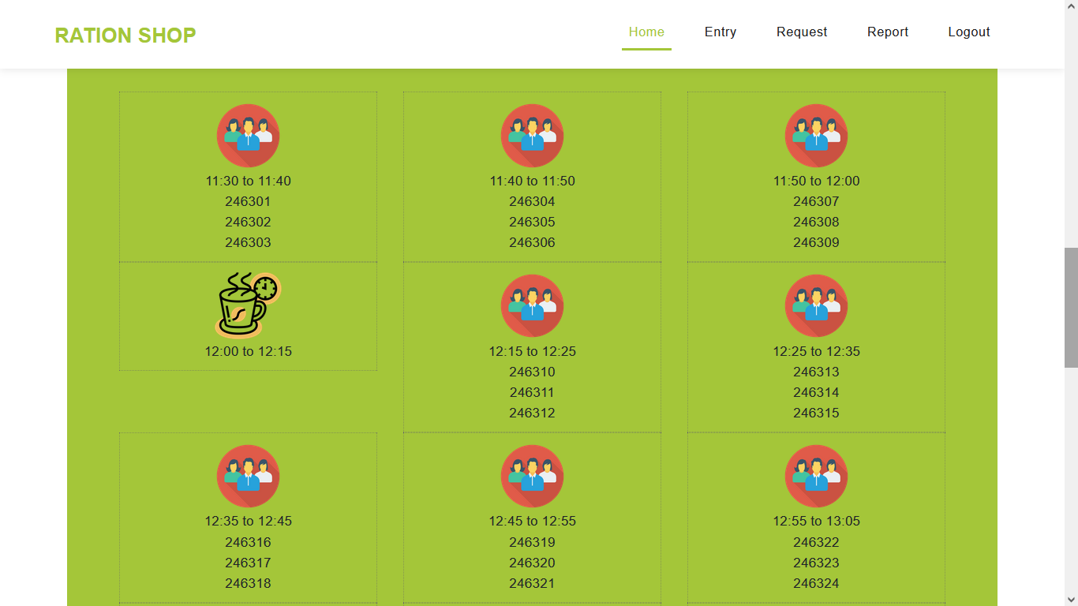
Development

Slide 33
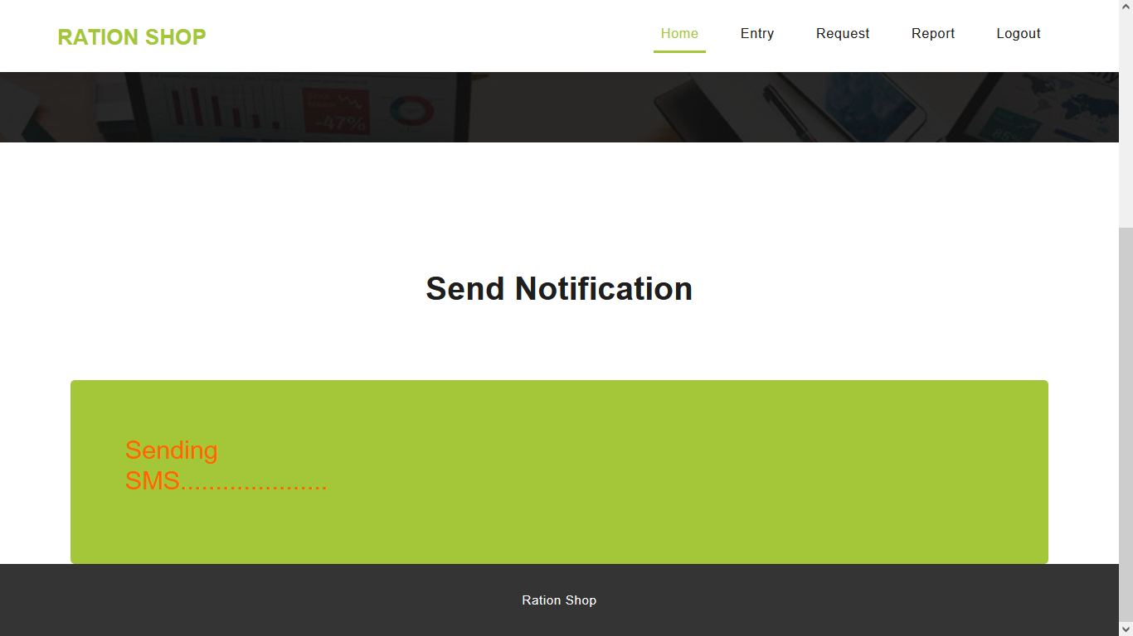
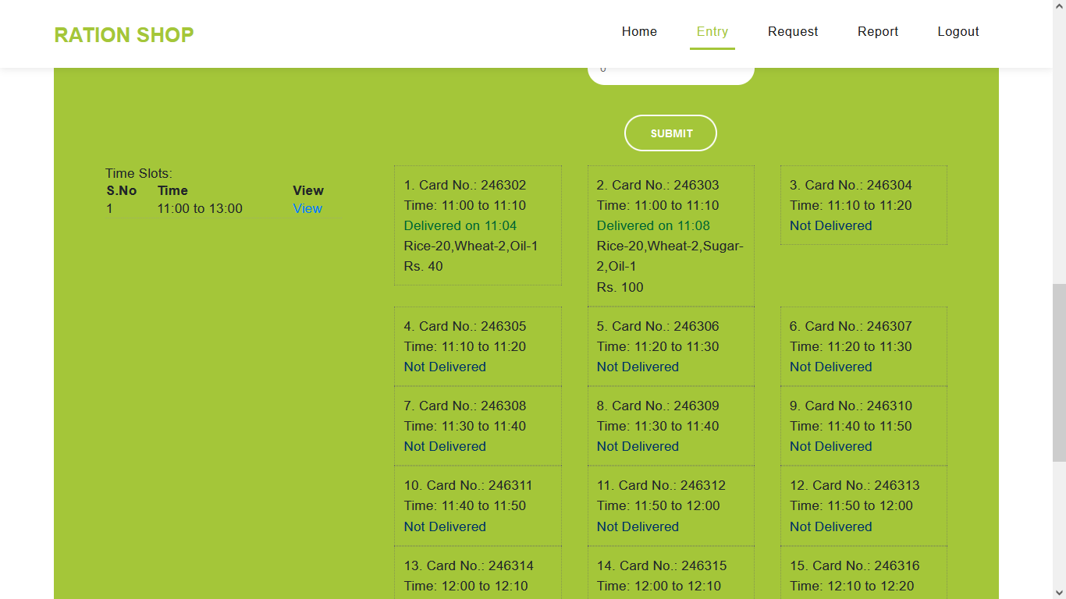
Development

Slide 34
Conclusion
Physically queuing is a reality on many industries that provide services or sell goods. Waiting in a queue can be stressful and exhausting for the clients because of the enforced idle time, and may lead to decreased customer satisfaction.
In this project, we have explored how reinforcement learning can be used for predicting the slot with time of people in fair Price Shop.
Virtual queuing system can be successfully implemented in environment where crowd management is difficult and thus help in the elimination of physical lines and waiting time all over the country in service-based institutions and organizations.

Slide 35
THANK YOU

